Slide 1


咨询建议书
Parallel DBSCAN on Spark
Group 12: Wang Jianming
Zhang Xinyue
Xing Zhenghao
Fu Chennan
2020/11/24
在此处插入文本。

Slide 2

Content
Introduction to DBSCAN
Naive parallel DBSCAN
Naive partition
Local DBSCAN
Merge
Optimization on partition
Reduce-boundry based partition
Content based partition
Conclusion

Slide 3

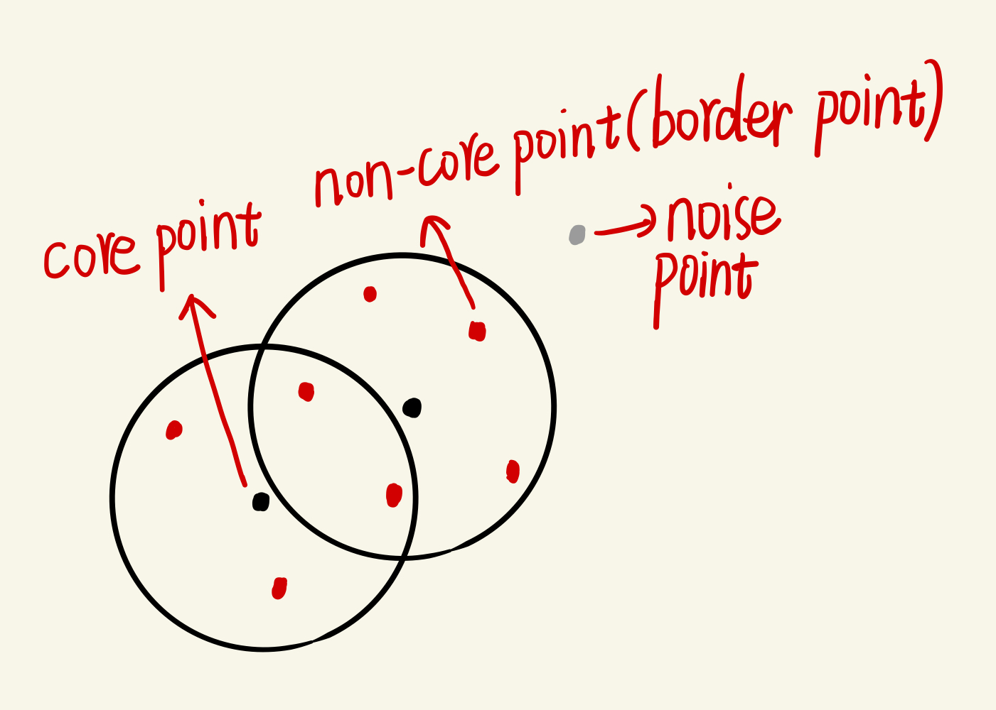
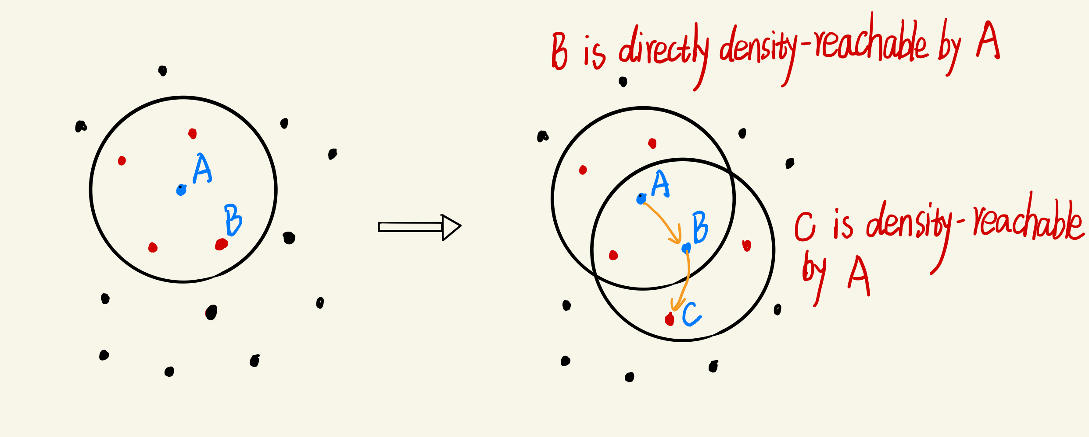
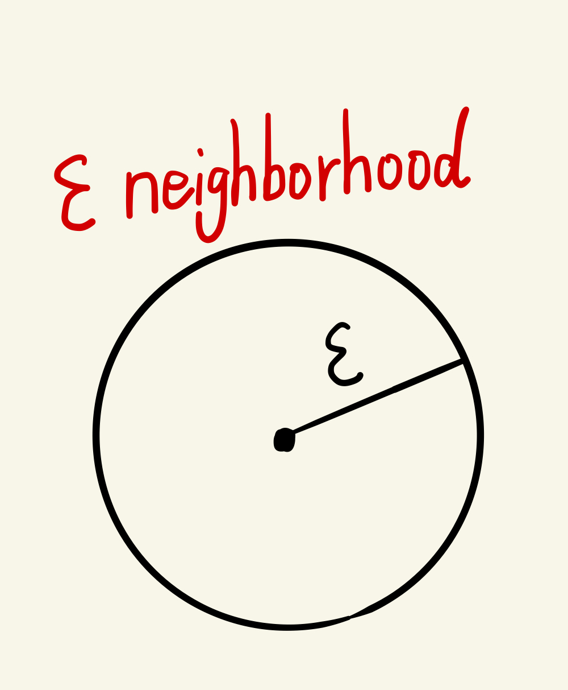
Local DBSCAN algorithm
Concepts:
ε(Eps) — the given radius
MinPts — the given minimal points
if MinPts = 4:
Core idea:
1. select a data point p arbitrarily from the data set.
2. determine whether p is a core point by Eps and MinPts.If p is a core point,find all the data point which are density-reachable from p to form a cluster. If not, select another point to do the same steps as before.

Slide 4
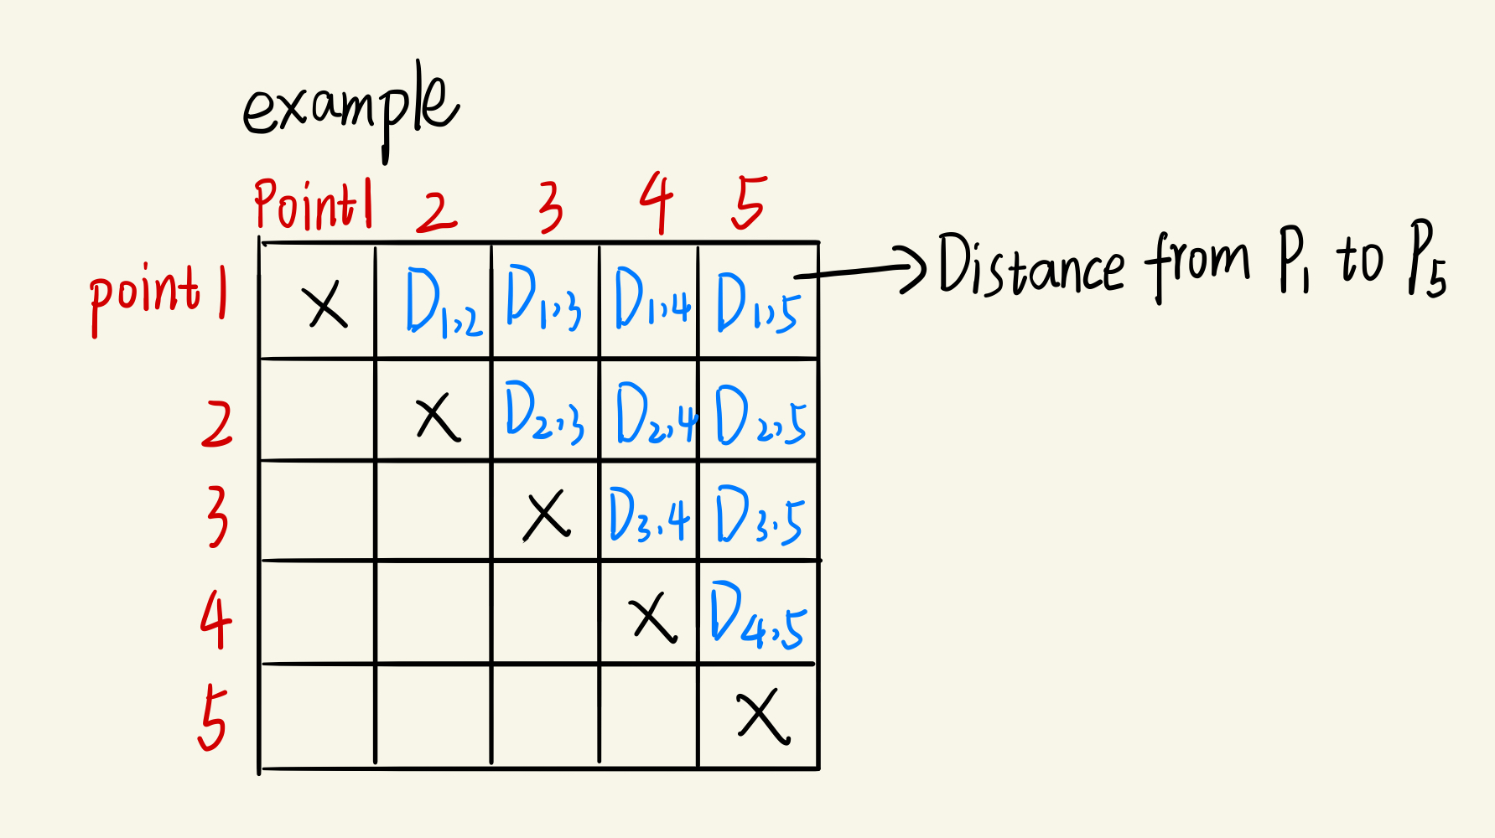
Matrix DBSCAN algorithm
Introduction: Build a matrix to hold all those point-pair distance value instead of computing every time.
Pros: In principle, the computational cost could be reduced by half, which is not big algorithm-wise improvement, but a giant increase in engineering, especially it comes to big data problem.

Slide 5
Parallel Matrix DBSCAN algorithm
Two Dimensional Example: (x, y)
Partition:
define partition number
define partition block position in the space
find the minimum x and y and find the maximum x and y
add eps to upper bound and minus eps to lower bound
divide the whole area into corresponding partition id (p_id)
build rdds (pid, dataset_points) by judging whether the points is in the partition area or n
Local DBSCAN:
each rdd will execute a matrix DBSCAN
each execution will return ((partition_dataset, core_point list), local_tags)
Merge:
update local tag list into global tag list
return final global tag list

Slide 6
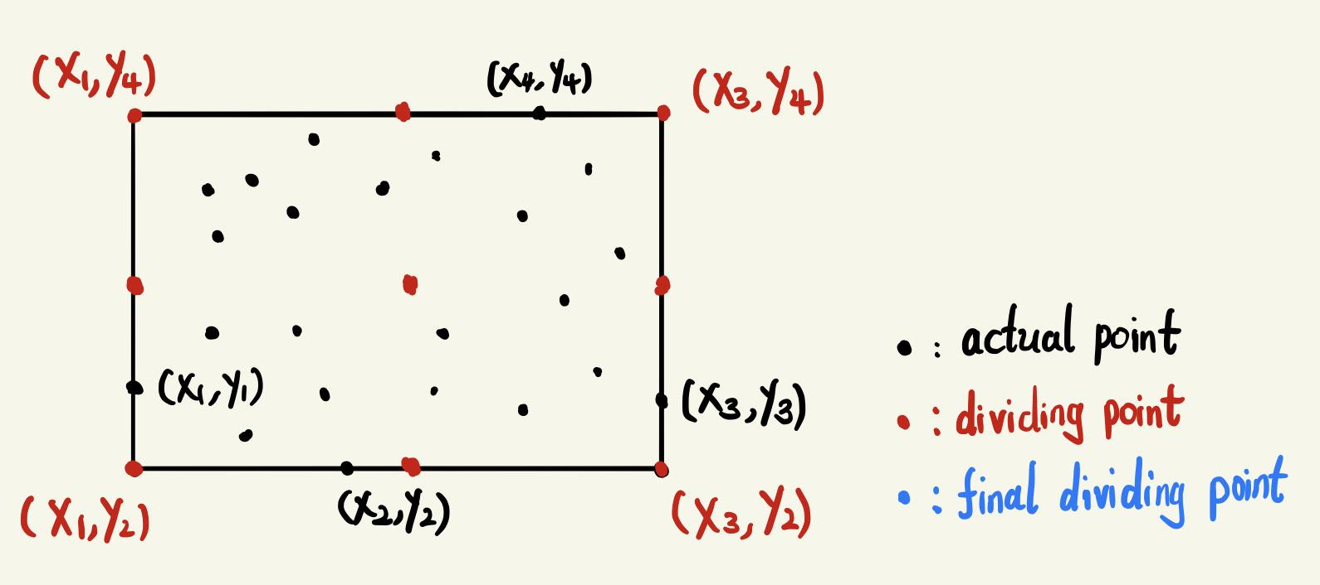
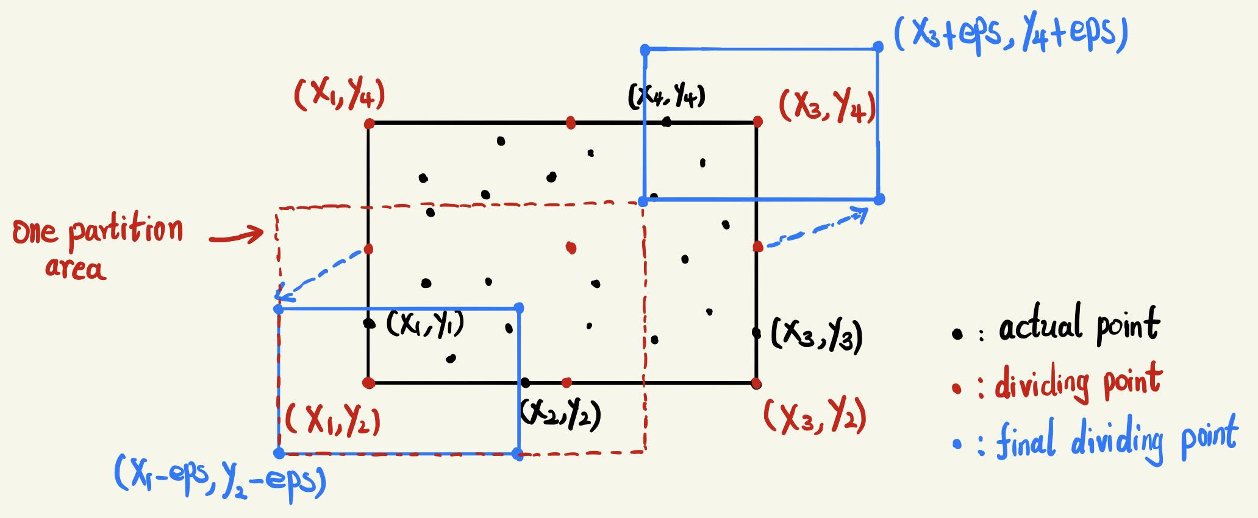
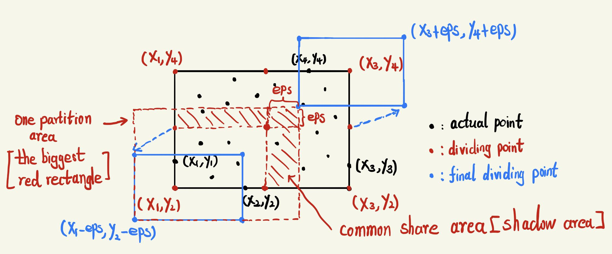
Parallel Matrix DBSCAN algorithm——Partition
partition number: 4 eps (epsilon): 3 MinPts (minimum points): 2
Define partition block position in the space

Slide 7
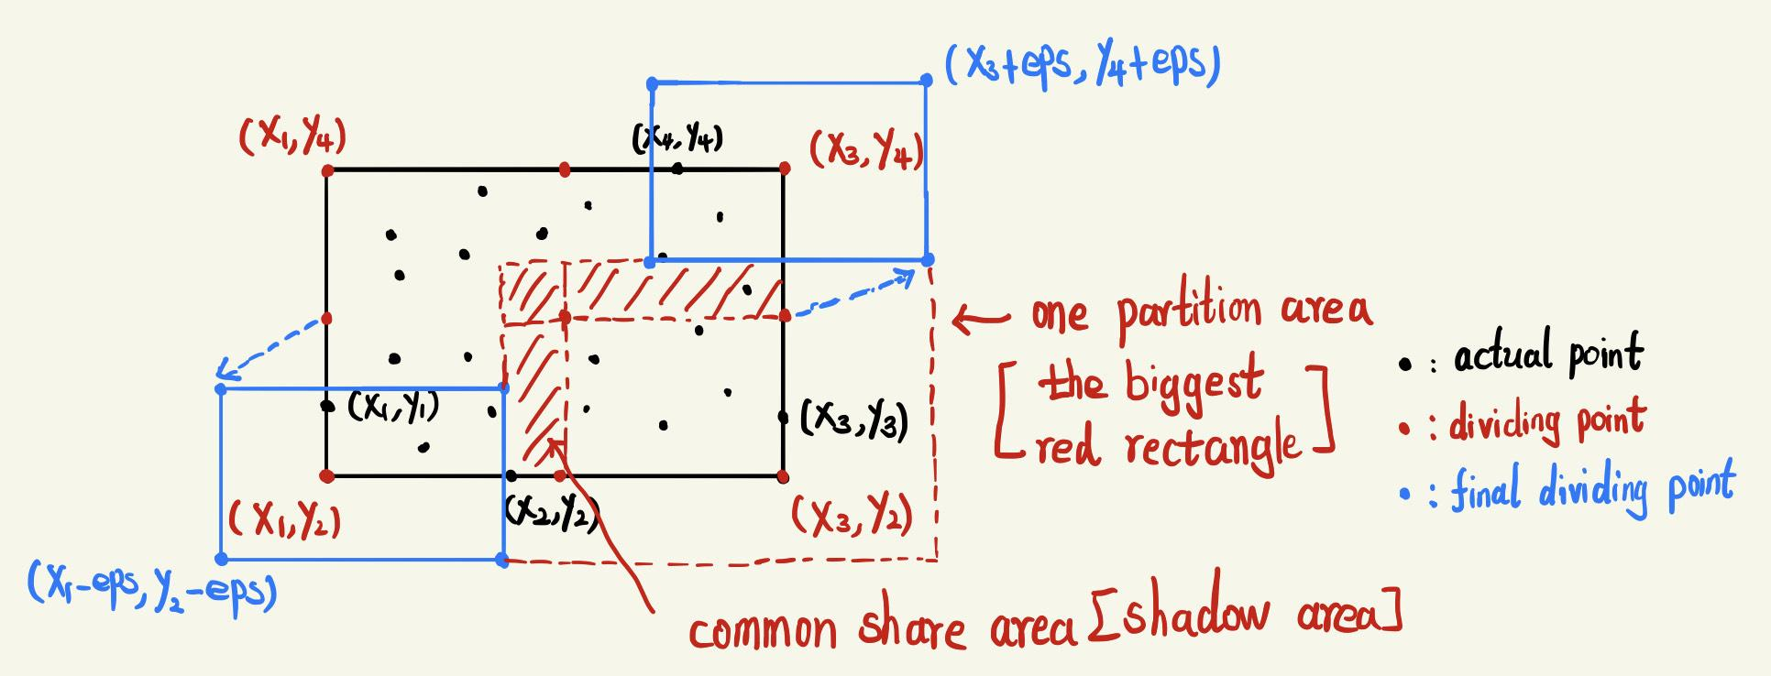
Parallel Matrix DBSCAN algorithm——Local Matrix DBSCAN
partition number: 4 eps (epsilon): 3 MinPts (minimum points): 2
Points in the red shadow area will have multiple labels

Slide 8
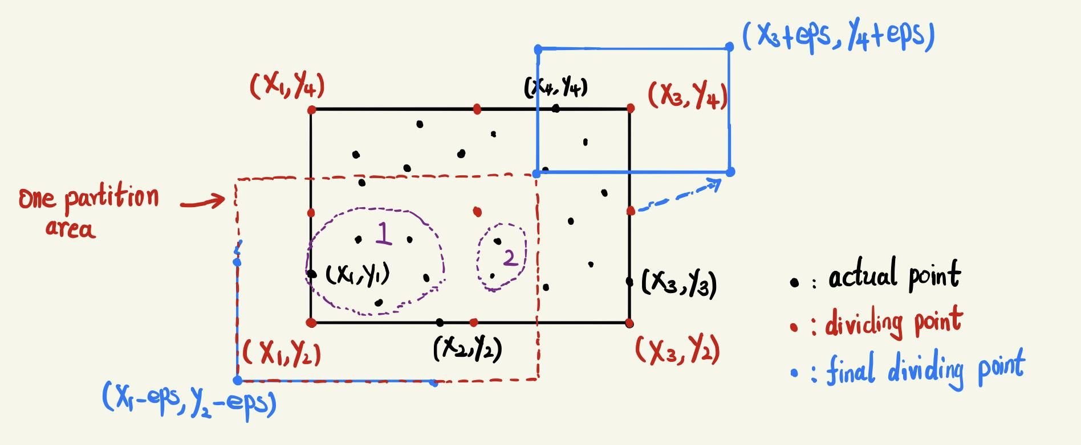
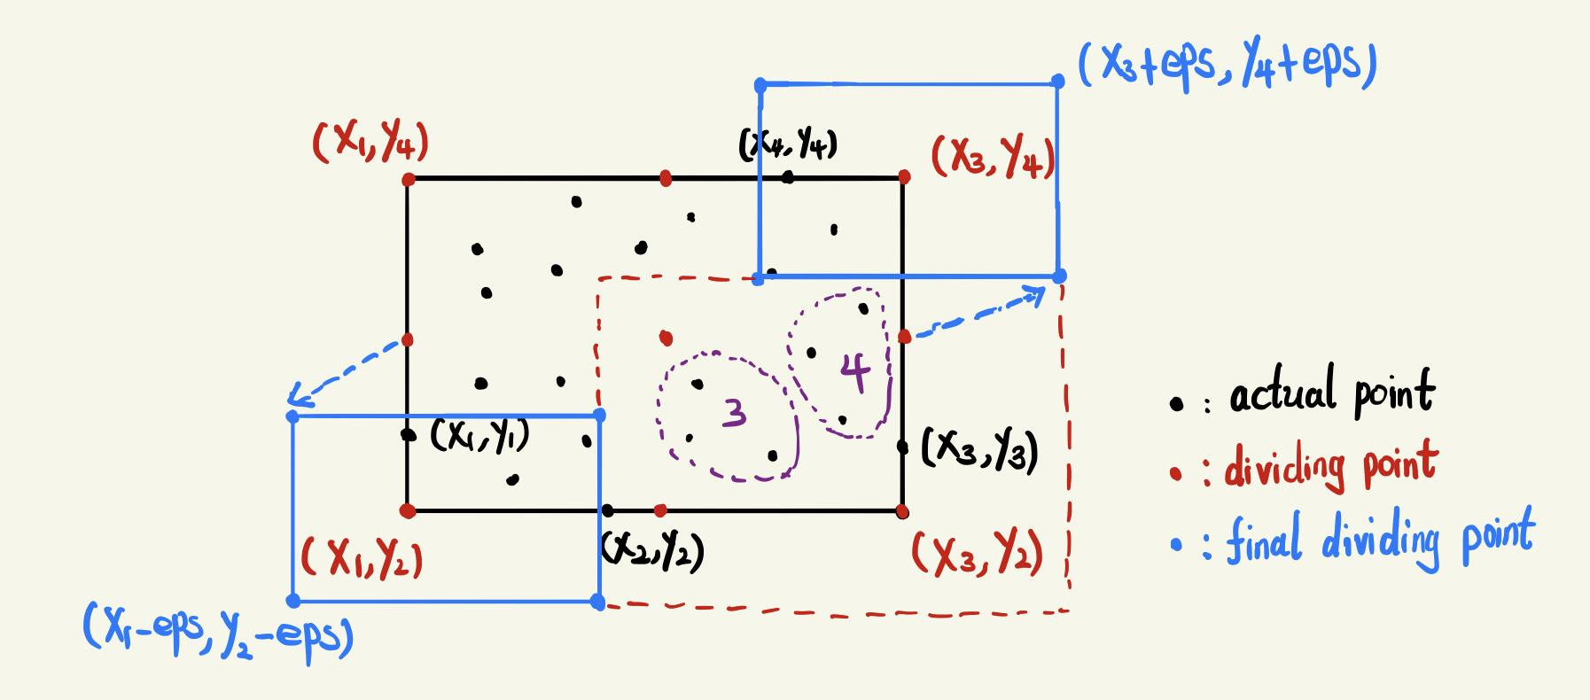
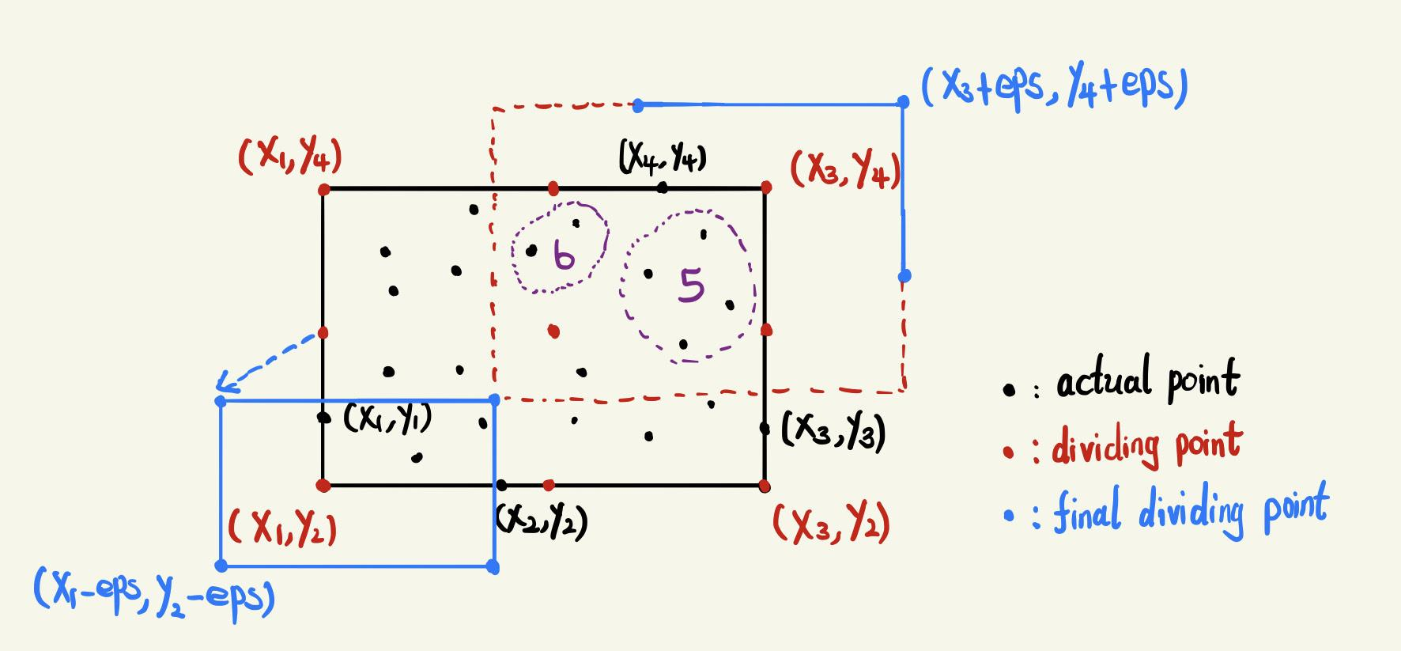
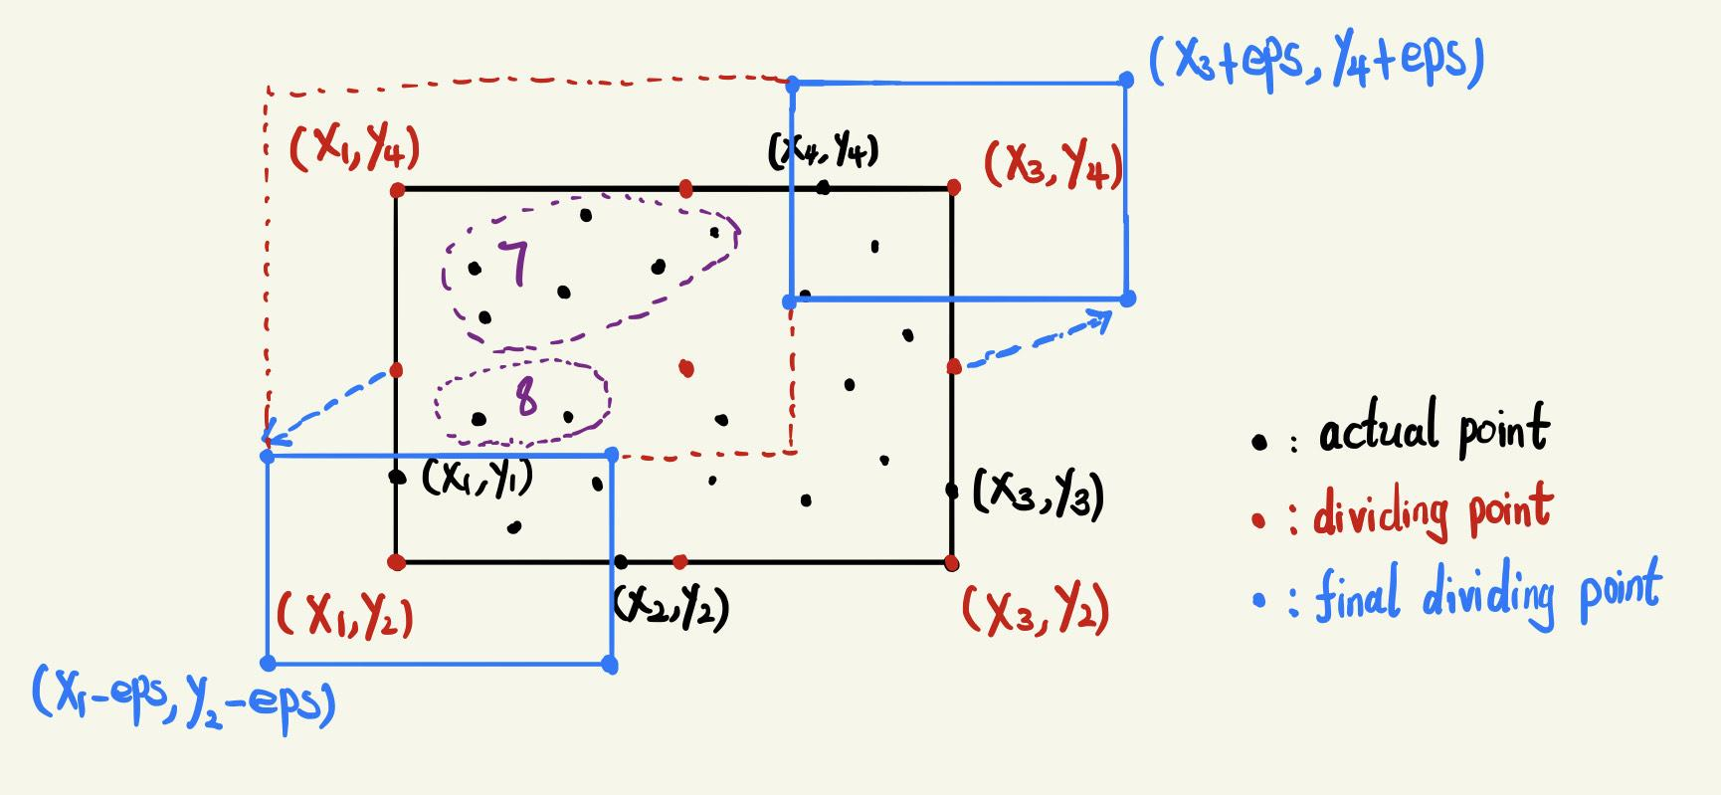
Parallel Matrix DBSCAN algorithm——Local Matrix DBSCAN
partition number: 4 eps (epsilon): 3 MinPts (minimum points): 2

Slide 9
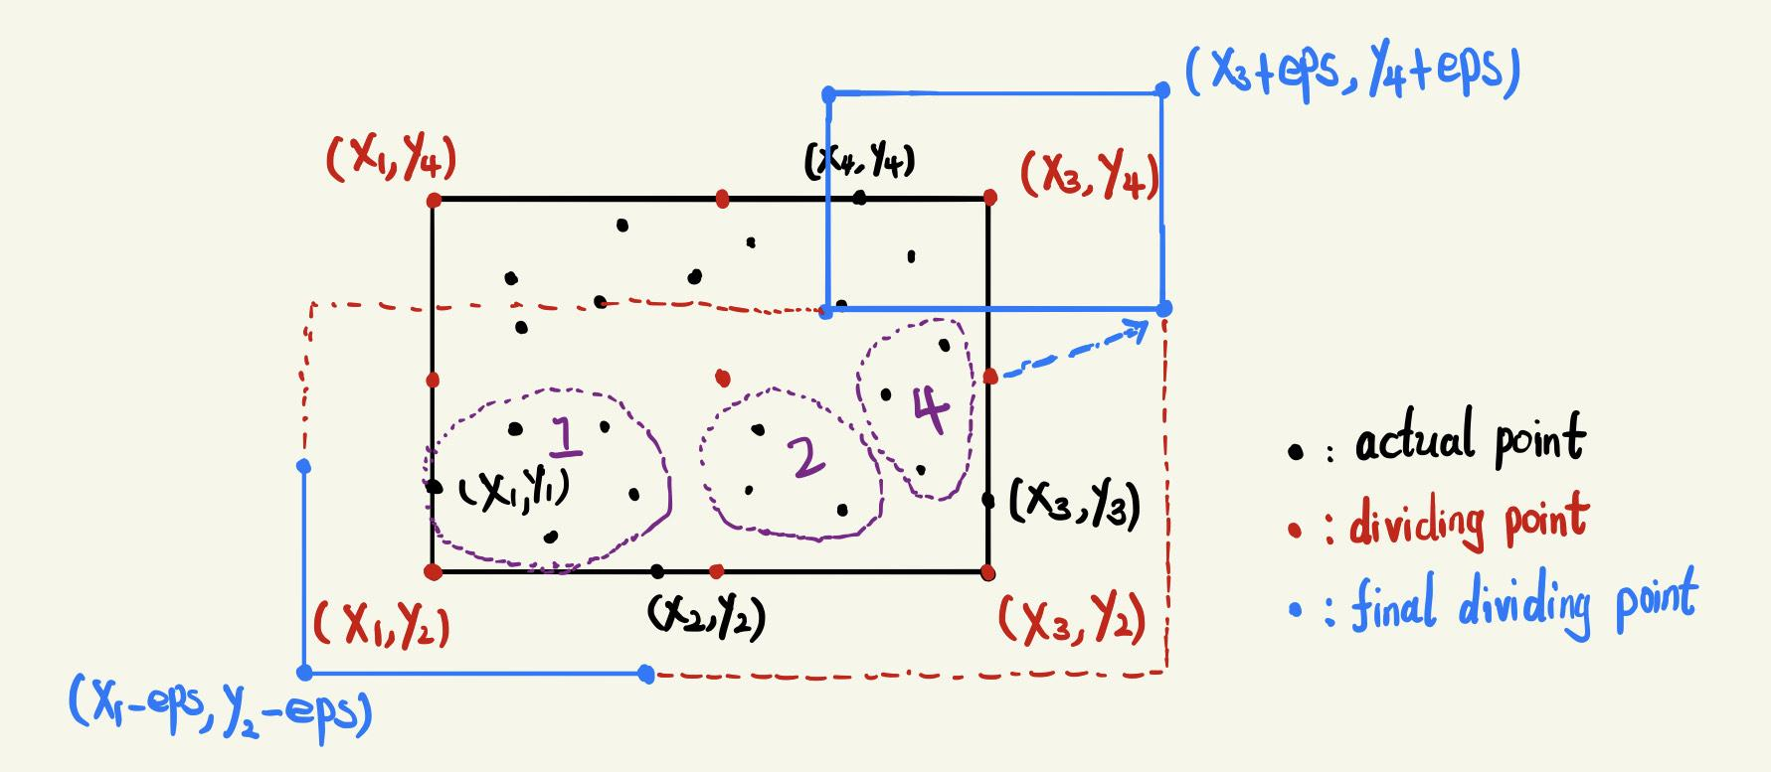
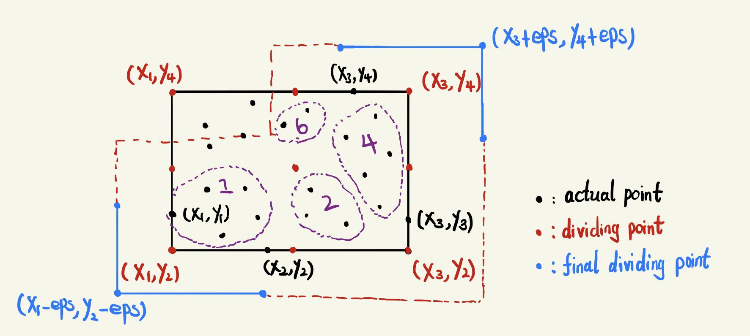
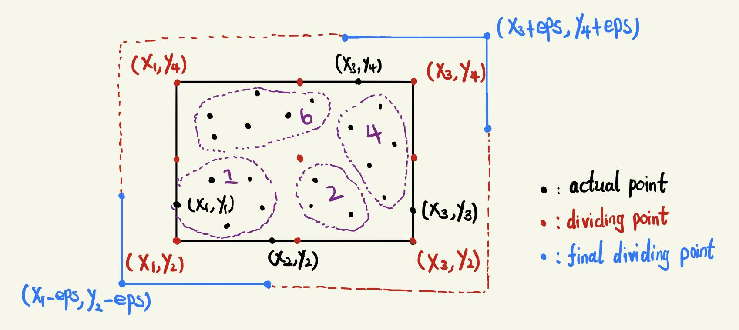
Parallel Matrix DBSCAN algorithm——Merge
partition number: 4 eps (epsilon): 3 MinPts (minimum points): 2
Using local labels to update global labels for all clusters

Slide 10
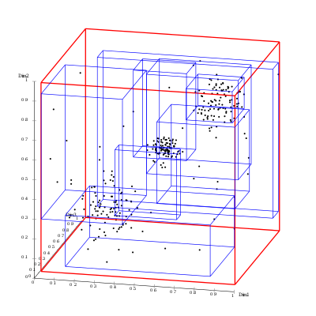
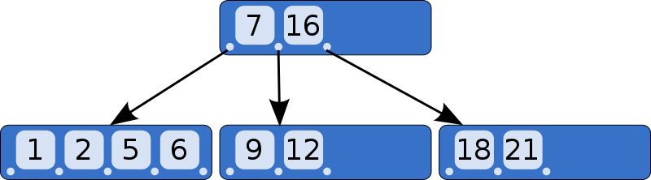
Optimization on partition——R tree
B-tree：
A self-balancing tree data structure
R-tree：
A tree data structures used for spatial access methods
Notes:
that maintains sorted data and allows searches, sequential access, insertions, and deletions in logarithmic time.

Slide 11
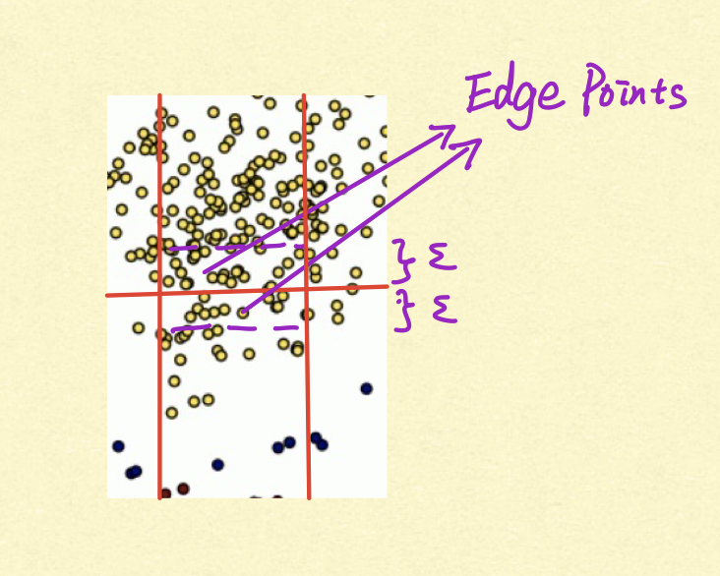
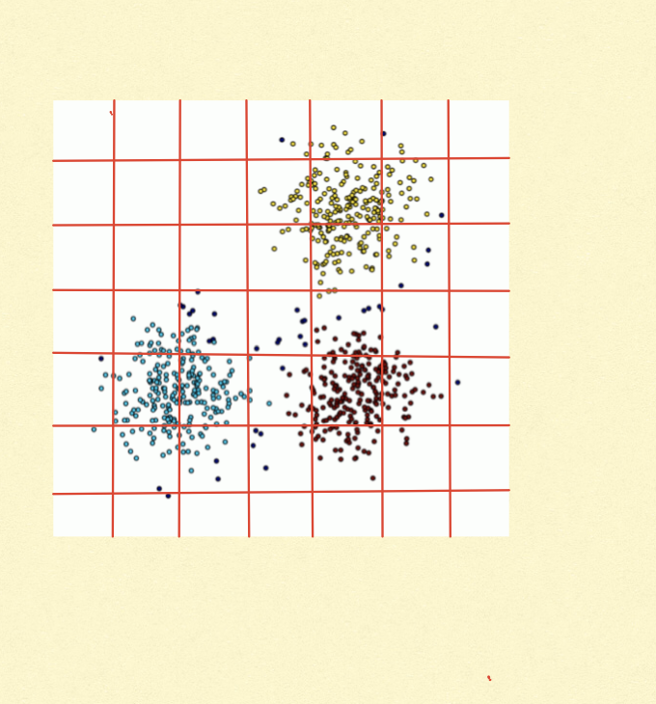

Optimization on partition——R tree (Boundary-based Strategy)
🙅‍♂️
Reduce the amount of edge points
Make sure workload of each worker as balanced as possible

Slide 12
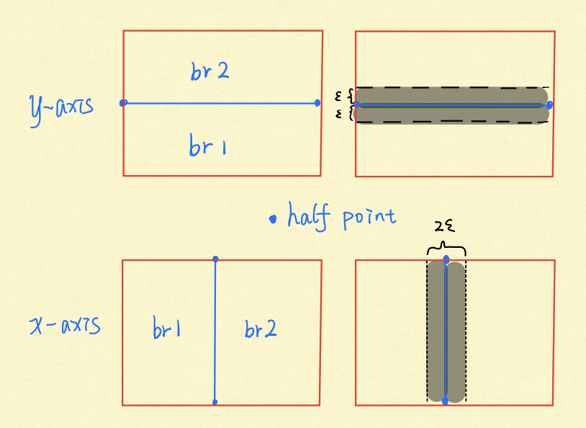

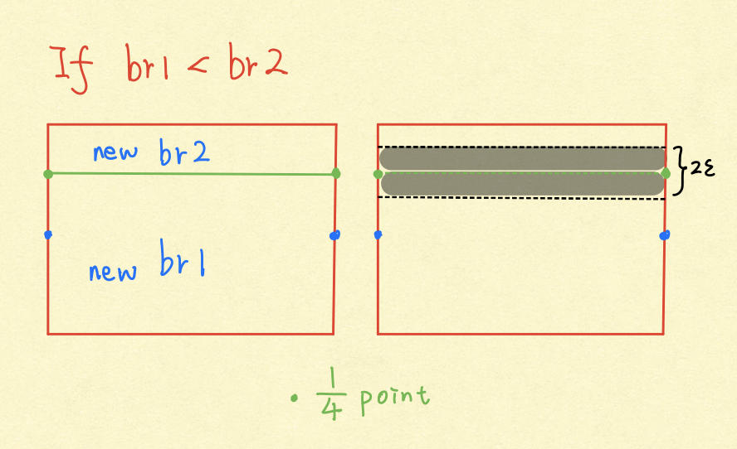

Optimization on partition——R tree (Boundary-based Strategy)
Set max points number in partition - maxpoints
As for y-axis:
minimize Score = |# in br1 － # in br2| * （# in Black part）

Slide 13
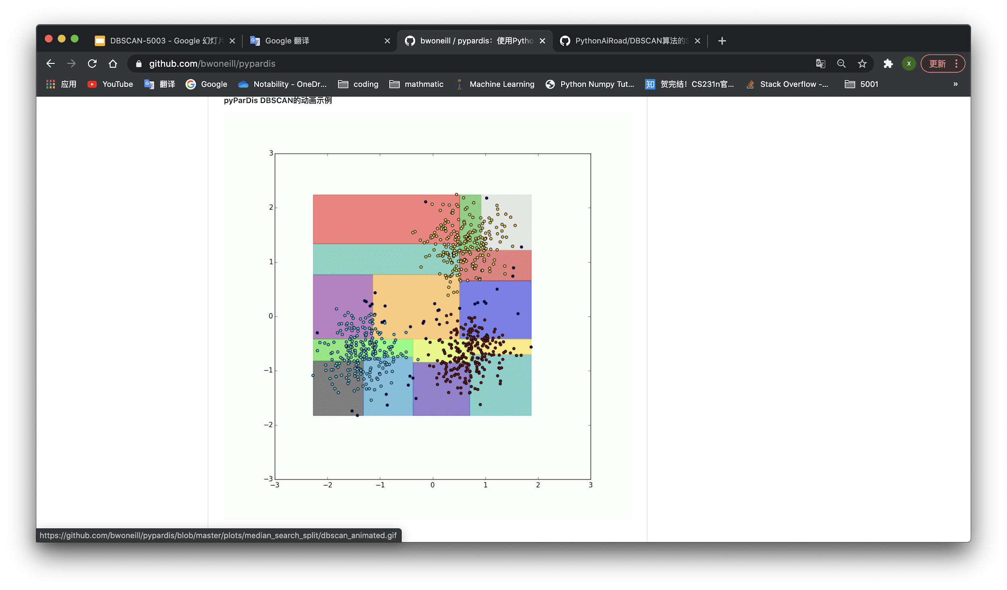
Optimization on partition——R tree (Boundary-based Strategy)
Max points number in partition - maxpoints
x-axis x_minScore
y-axis y_minScore
smaller one -> divide
👍
Put final br1 & br2 to queue （right hand）
Take out the leftmost mbr in the queue in turn to do the above calculation

Slide 14

Optimization on partition——R tree (Cost-based Strategy)
Goal: Make the workload (# of points) of partitioned region as balanced as possible.
Input: S (The rectangle to be split)
Output: S1 and S2 such that S1∪S S2 = S
Calculate the cost difference between S1 and S2
(after applyng the selected split line)
Split line + eps * 2 beyond the boudary
(Get the best split line from the record!)
Min Cost Differience ← ∞
Notes:
that maintains sorted data and allows searches, sequential access, insertions, and deletions in logarithmic time.

Slide 15
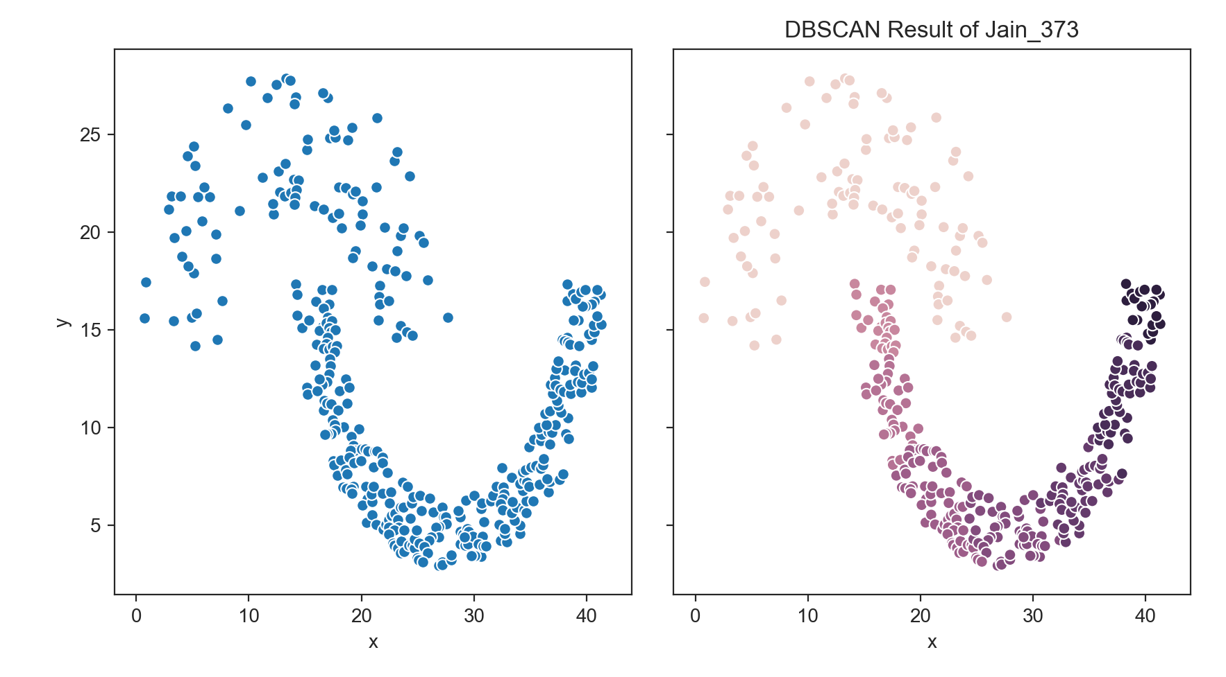
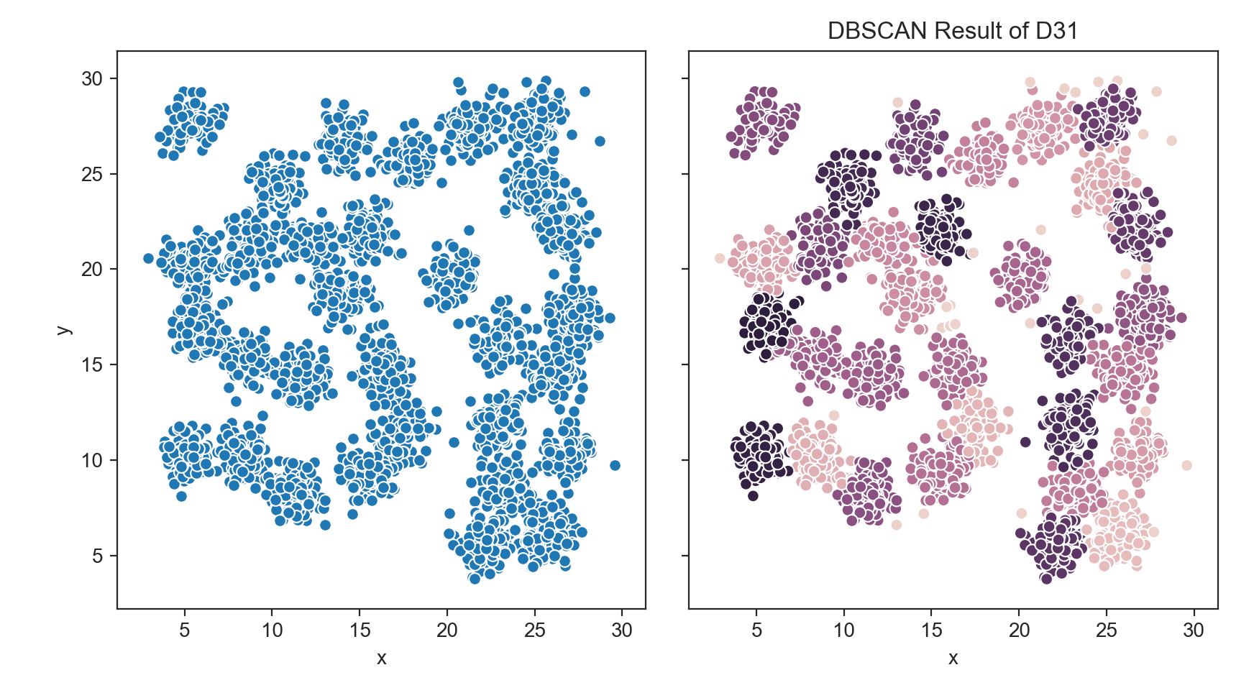
Conclusion
Jain
D31
Partition Number | 4 | 8 | 10
Naive | 1179ms | 797ms | 808ms
Parallel Matrix DBSCAN | 422ms | 385ms | 380ms
Rtree - rbp | 360ms | 330ms | 289ms
Rtree - cbp | 308ms | 284ms | 271ms
Partition Number | 4 | 8 | 10
Naive | 26410ms | 19415ms | 18483ms
Parallel Matrix DBSCAN | 6730ms | 5590ms | 4564ms
Rtree - rbp | 7993ms | 5722ms | 5328ms
Rtree - cbp | 6977ms | 5652ms | 5164ms
Notes:
that maintains sorted data and allows searches, sequential access, insertions, and deletions in logarithmic time.

Slide 16
Conclusion
Performance
Sclability
Bottle neck (Master)
Know your data
Future Work:
Now: using number of points to measure workload when doing partition
Future: using the real cost (maybe considering density) of DBSCAN to measure workload
More expreiments on large volume datasets with large partitions
Partition Number | 4 | 8 | 10
Naive | 1179ms | 797ms | 808ms
Parallel Matrix DBSCAN | 422ms | 385ms | 380ms
Rtree - rbp | 360ms | 330ms | 289ms
Rtree - cbp | 308ms | 284ms | 271ms
Partition Number | 4 | 8 | 10
Naive | 26410ms | 19415ms | 18483ms
Parallel Matrix DBSCAN | 6730ms | 5590ms | 4564ms
Rtree - rbp | 7993ms | 5722ms | 5628ms
Rtree - cbp | 6977ms | 5652ms | 5264ms
Notes:
that maintains sorted data and allows searches, sequential access, insertions, and deletions in logarithmic time.

Slide 17
Reference
[1] DBSCAN Wikipedia. https://en.wikipedia.org/wiki/DBSCAN
[2] Guttman, A. (1984). R-trees: a dynamic index structure for spatial searching. ACM SIGMOD International Conference on Management of Data.
[3] Huang, Fang &. Zhu, Qiang &. Zhou, Ji &. Tao, Jian &. Zhou, Xiaocheng &. Jin, Du &. Tan, Xicheng &. Wang, Lizhe. (2017). Research on the Parallelization of the DBSCAN Clustering Algorithm for Spatial Data Mining Based on the Spark Platform. Remote Sensing. 9. 10.3390/rs9121301.
[4] He, Yaobin &. Tan, Haoyu &. Luo, Wuman &. Feng, Shengzhong &. Fan, Jianping. (2014). MR-DBSCAN: a scalable MapReduce-based DBSCAN algorithm for heavily skewed data. Frontiers of Computer Science. 8. 10.1007/s11704-013-3158-3.
[5] Chernishev, G &. Smirnov, K &. Fedotovsky, P &. Erokhin, G &. Cherednik, K. (2013). To Sort or not to Sort: The Evaluation of R-Tree and B+-Tree in Transactional Environment with Ordered Result Set Requirement. SYRCoDIS.
[6] Clustering basic benchmark. http://cs.joensuu.fi/sipu/datasets/
[7] Phnix-wu, Full analysis of spatial data index RTree, https://blog.csdn.net/wzf1993/article/details/79547037, 2018/03/12.
Notes:
that maintains sorted data and allows searches, sequential access, insertions, and deletions in logarithmic time.

